Slide 1
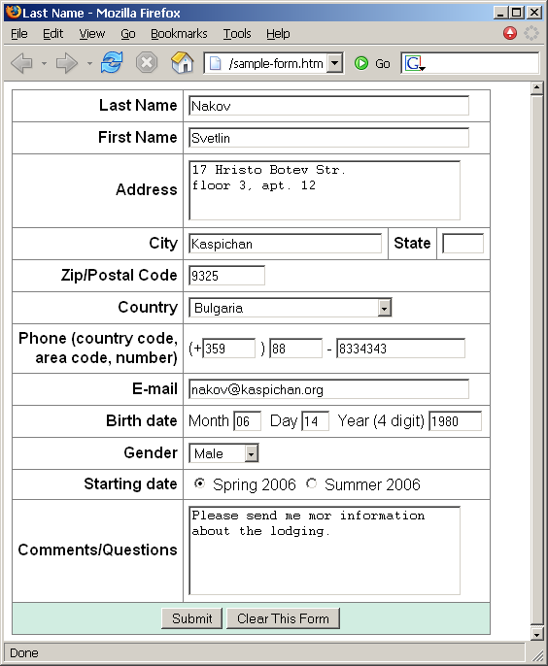
Homework
Create a Web form that looks like this sample:

Slide 2
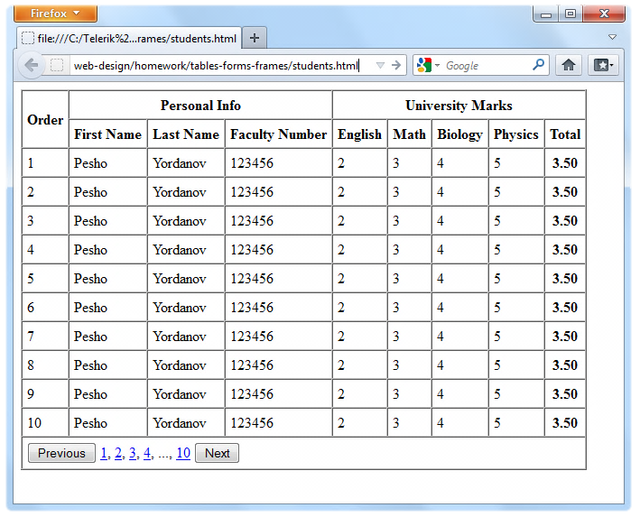
Homework (2)
Create the following using tables and forms:

Slide 3
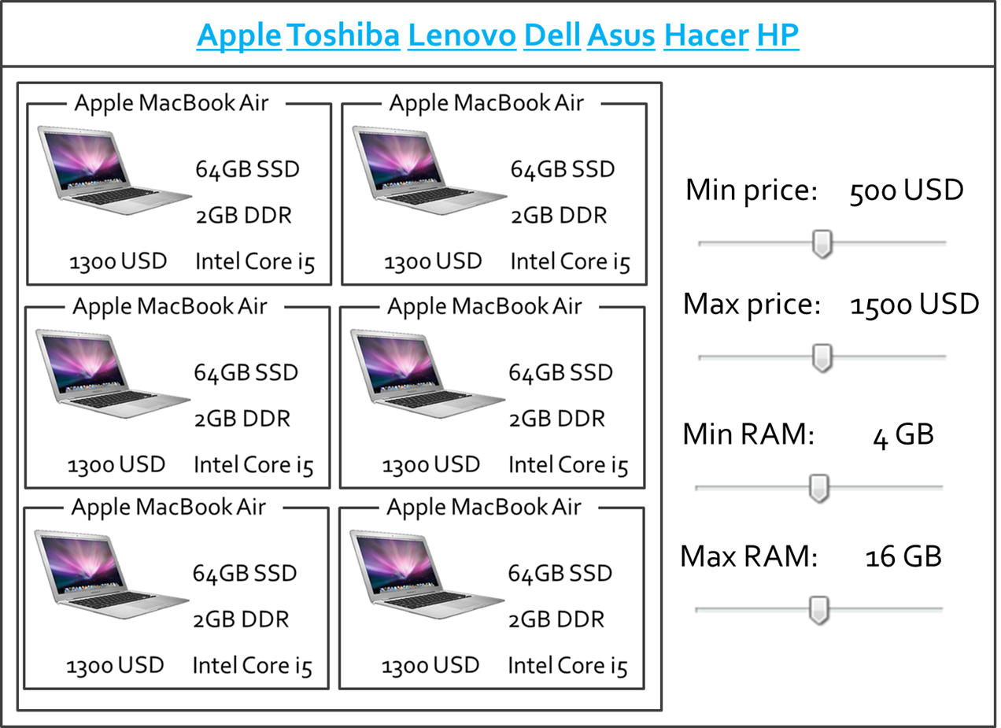
Homework (3)
Create the following HTML Page
Hint: Use Fieldsets and Nested tables

Slide 4
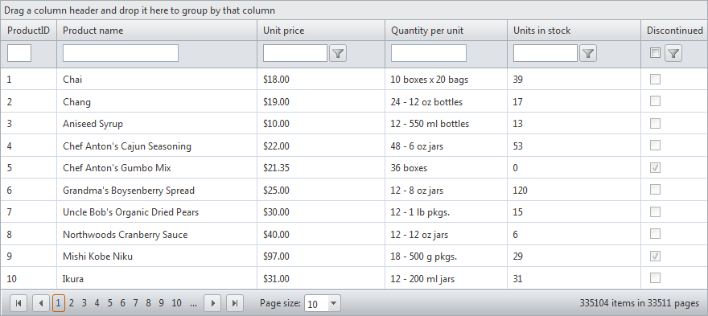
Homework (4)
*Construct the following Grid component:
Try to make a HTML page, that looks just like the example
CSS is required

